Slide 1
Population Health Equity and Response Tool

Slide 2

The Motivation
Public health teams today don’t have a single, clear way to identify which communities need help first. Data exists, but it’s fragmented across systems making it difficult to prioritize action quickly, especially in crises like opioid harm.

Slide 3
The Problem
This leads to:
Right now, decision-makers have to look at multiple disconnected indicators - access to care, socioeconomic factors, wait times, and opioid harm trends- but there’s no unified way to combine them into one actionable view.
01.
Delayed Response
02.
Inefficient resource allocation
Underserved communities being missed
03.

Slide 4
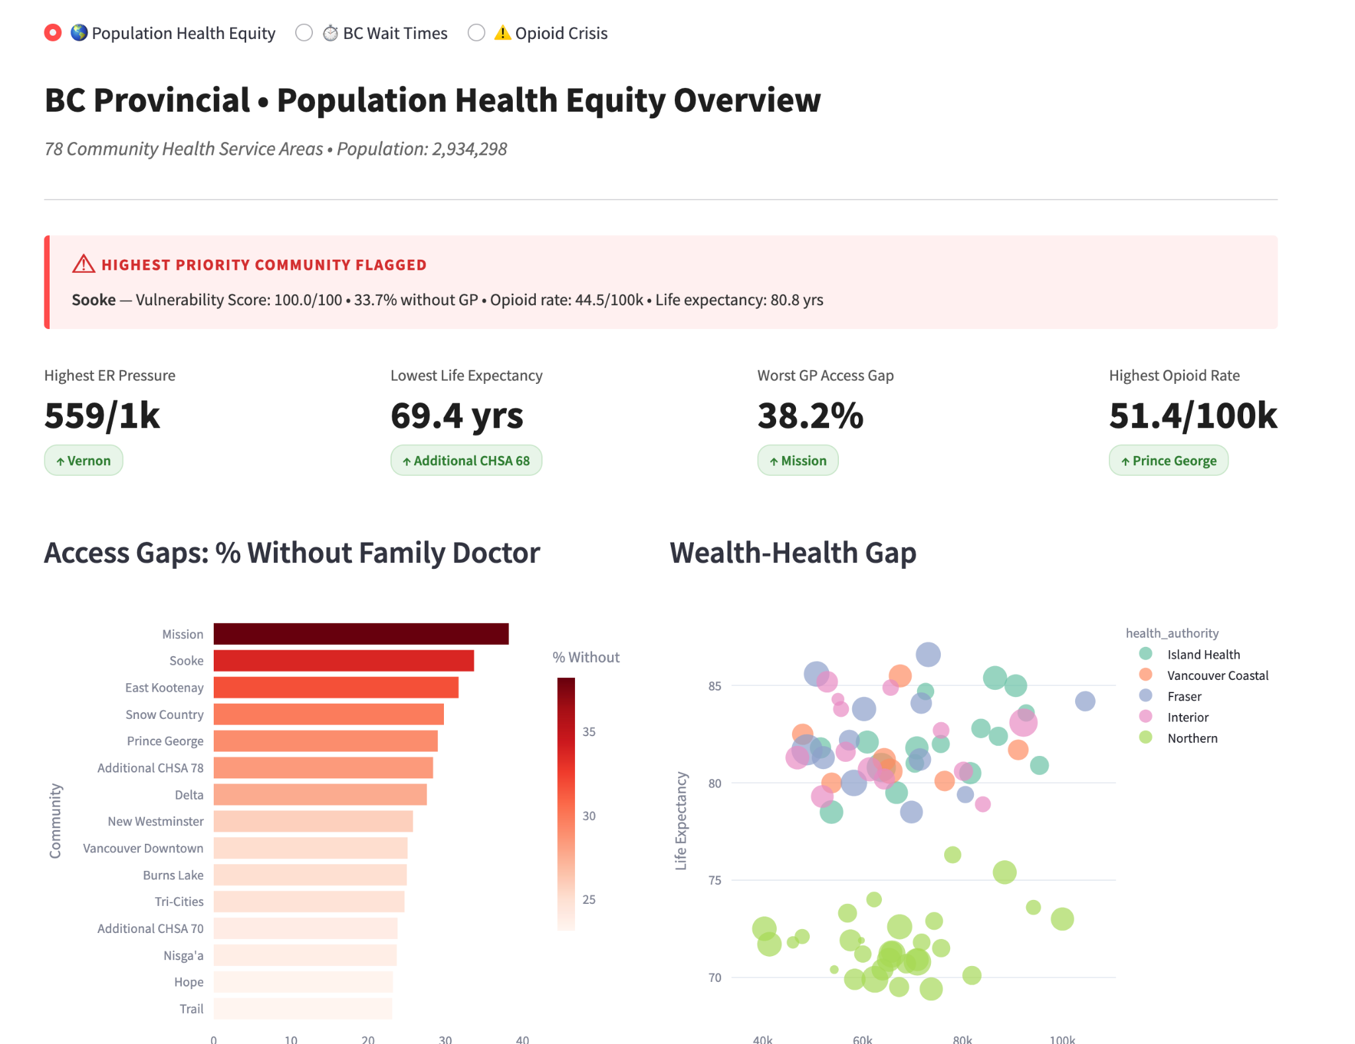
So we built a Population Health Equity and Response Tool that brings all of this together into one
platform.

Slide 5

It helps public health teams:
Identify high-risk communities
Understand why they are vulnerable
Demo: https://bc-health-dashboardant-dscjbe2qtshtpkzi6mp775.streamlit.app/
Track system pressures and harm trends

Slide 6
What makes this tool powerful is that it connects all three perspectives:
Equity - Who is most vulnerable
Opioid data - Where harm is rising
Wait times - Where the system is strained
Together this helps decision-makers not just see the problem, but understand where to act first

Slide 7

Impact
This tool could help public health teams:
Prioritize resource allocation
Target interventions more effectively
Communicate data clearly to stakeholders
Ultimately improving outcomes for underserved communities.
Our goal is simple - turn complex health data into clear, actionable insights that support faster and more equitable decisions.

Slide 8
Thank you!

